Slide 1
R GUI building
Chen Hao
7 Oct 2014

Slide 2
GUIs are used to allow the user to easily accomplish the tasks in hand.
Many more R GUIs are now available:
- Tcl/Tk, rpanel.
- Gtk, Gwidgets, PMG (Poor Man’s GUI).
- Java based GUIs: rJava, JGR
- Web based: Rpad,Rwui.
Notes:
The gWidgets package provides a convenient means to create rapidly small to medium-size GUIs within R. Unlike the underlying toolkits, gWidgets has relatively few constructors and methods, which mean it is relatively easy to learn, allowing for rapid prototyping. (but as project progress, one might need to move to a more powerful underlying toolkit). The gWidgets package works with different operating systems and different GUI toolkits. This shows, the same code using the RGtk2, tcltk, qtbase packages for a toolkit.
Despite Tk’s limitations as a graphical toolkit as compared to GTK+ or Qt, the Tk libraries are widely used for R GUIs.

Slide 3
tcltk
Tcl: Tool Command Language - in the late 1980s by John Ousterhout
Tk: is an extension of Tcl that provides GUI components through Tcl - in 1990, again by John Ousterhout
Tcl/Tk is a combination of a scripting language and a toolkit for graphical user interfaces.
Notes:
it made programming GUIs for X11 easier and faster. There are a large number of language bindings available for Tk, including Perl, Python, Ruby, and, through the tcltk package, R. The tcltk package was developed by Peter Dalgaard and has been included with base R since version 1.1.0. The tcltk2
package provides additional bindings and bundles in some useful external TCL code. Our focus here is limited to the base tcltk package.
R for Windows has been bundled with the necessary Tk version for years, so there are no installation issues for that platform. For Linux users, it is typically trivial to install the newer libraries, and for Mac OS X users, the provided binary installations include the newer Tk libraries.
The R manual pages simply redirect the reader to the original Tk documentation, hard to check the use of tcltk.
Tk has a well-documented API[10] (www.tcl.tk/man/tcl8.5). There are also several books to supplement. We consulted the one by Welch, Jones and Hobbs[1] often in the development of this material. The online sample chapter on geometry management of Walsh[13] was perused, as it provides
a thorough discussion of that topic. In addition, the Tk Tutorial of Mark Roseman[9] (www.tkdocs.com/tutorial) provides much detail. Rspecific
documentation includes two excellent R News articles and a proceedings paper[3][5][4] by Peter Dalgaard, the package author. A set of examples
by James Wettenhall[14] are also quite instructive. A main use of tcltk is within the Rcmdr framework. Writing extensions for that is well documented in an R News article[6] by John Fox, the package author.

Slide 4
The most usual case for building a R GUI using **tcltk** is to defines a top-level window first and the second an underlying frame container. We then define and place the widgets.
Notes:
The tcltk package creates objects with a few different classes, tclObj being the primary one (tclVar and tkwin are two other important ones). The tclObj objects print with the leading <Tcl>. The string representation of objects of class tclObj is returned by tclvalue or by coercion through the as.character function. These two differ in how they treat spaces and new lines. Conversion to vectors of mode character, double, integer, and logical is possible, though, in general, direct conversion of complicated Tcl expressions is not supported. We can create objects of this class through as.tclObj.

Slide 5
Widgets
A widget is a GUI element, like buttons, scrollbars, text areas etc.
Tk comes with a selection of basic widgets:
basic widgets – labels, entry widgets, and buttons. These can be combined to form more complex GUI applications.
text editing windows
Sliders
text entry fields
Buttons
Labels
Menus
list boxes
canvas for drawing graphics
Notes:
Tk widgets are constructed as children of a parent object, with the parent specified to the constructor. It means other widget constructors require that a parent widget be specified as the first argument of the constructor.
A widget along the top or bottom is allocated a parcel just high enough to contain the widget, but occupying as much of the width of the container as possible, whereas widgets along the sides get a parcel of maximal height, but just wide enough to contain it.

Slide 6
Label : ttklabel()
Entry: tkentry()
Button: tkbutton()
Notes:
simple label, the following options are possible: anchor, background, font, foreground, justify, padding, relief, text, and wraplength. The main
option, text, takes a character string. The label will be multiline if it contains new line characters. The padding argument allows the specification
of space in pixels between the text of the label and the widget boundary. This may be set as four values (left, top, right, bottom), or fewer,
with bottom defaulting to top, right to left, and top to left. The relief argument specifies how a 3-D effect around the label should look, if specified.
Possible values are "flat", "groove", "raised", "ridge", "solid", and "sunken".

Slide 7
Layout and Containers
Top-level windows tktoplevel constructor. Basic options include the ability to specify the preferred width and height and to specify a menu bar through the menu argument.
Frames ttkframe constructor produces a themeable container that can be used to organize visible components within a GUI. Options include width and height to set the required size. The padding option can be used to put space between the border and subsequent children. The option borderwidth to specify a border around the frame of a given width, and relif to set the border style. Like “flat”, "groove", "raised", "ridge", "solid", and "sunken".

Slide 8
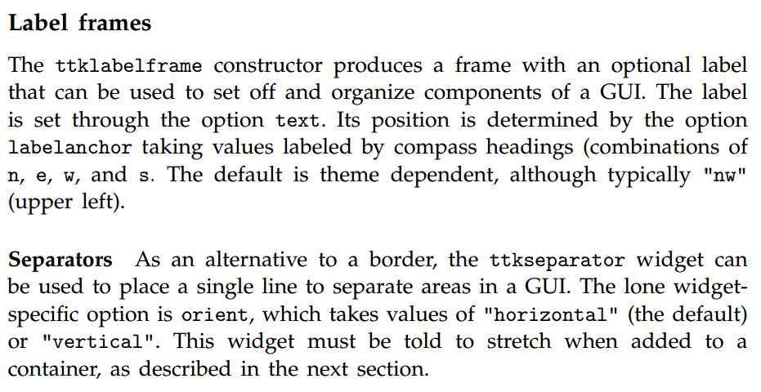

Slide 9
Geometry managers
The tkpack function will place children into their parent in a boxlike manner
When simultaneous horizontal and vertical alignment of child components is desired, the tkgrid function can be used to manage the components.

